Slide 1
Constrained Texture Mapping
資訊所 P76031234 涂利民
資訊所 P76034240 謝一豪

Slide 2
Outline
Motivation & Goal
Flow Chart
Feature Embedding
Align Feature Points
User Interface
Result
Demo
Reference

Slide 3
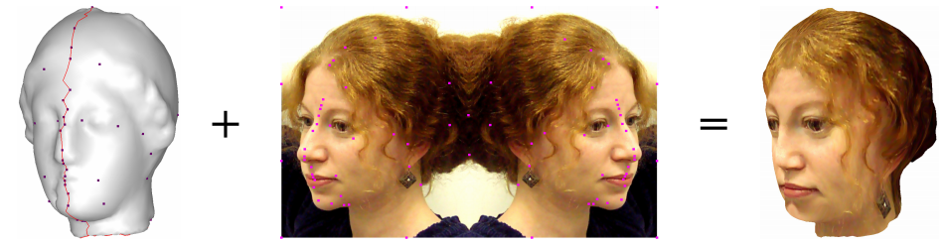
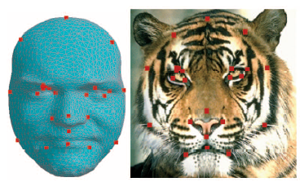
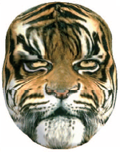
Motivation & Goal
To attach a face image onto a 3D model with corresponding features.

Slide 4
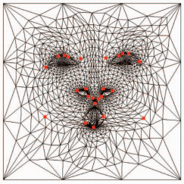
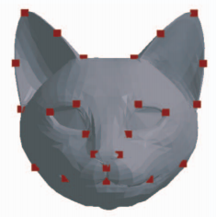
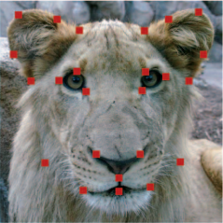
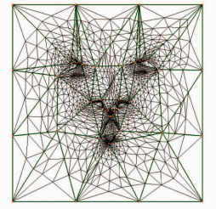
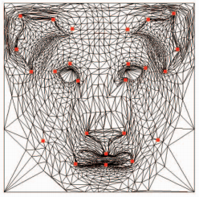
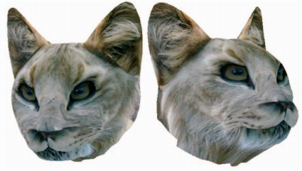
Flow Chart
Input
Feature Embedding
3D model (cat)
Image (lion)
Align Feature Points
Output

Slide 5
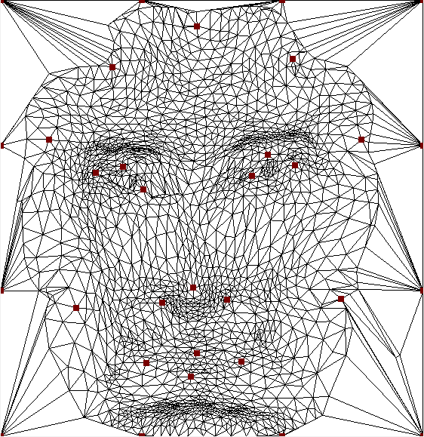
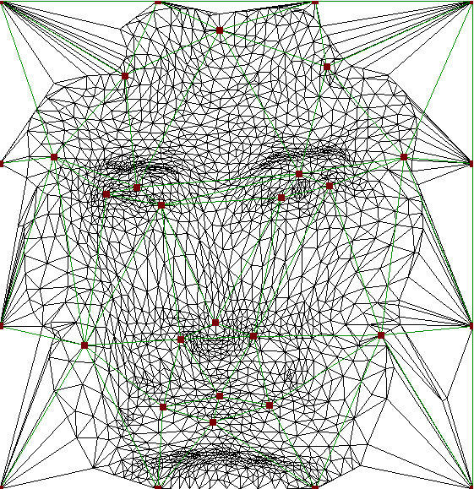
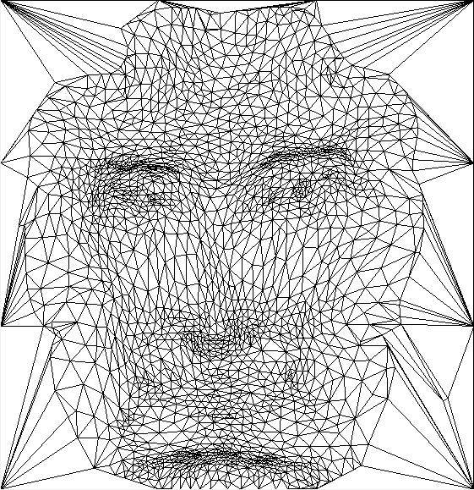
Feature Embedding
Define the feature points of 3D face model. Embed the feature points into the UV map and mesh these feature points.
Feature points embedding
Feature points mesh
UV map

Slide 6
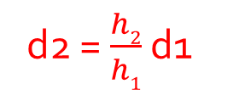
Align Feature Points
When moving feature points, the points inside adjacent triangles will move proportionally.
d1
h1
d2 = $\frac{h2}{h1}$ d1
d2
h2

Slide 7
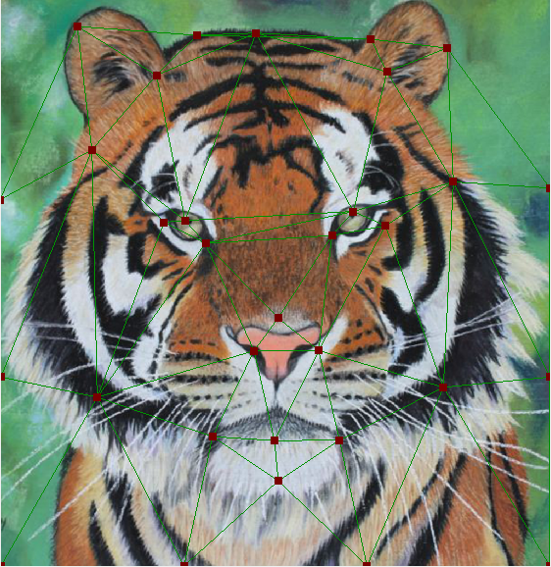
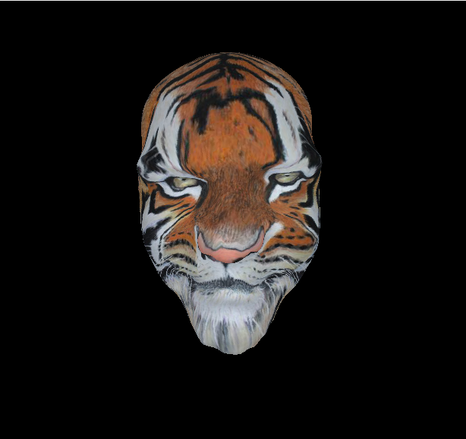
Result
Paper
Result
Our
Result

Slide 8
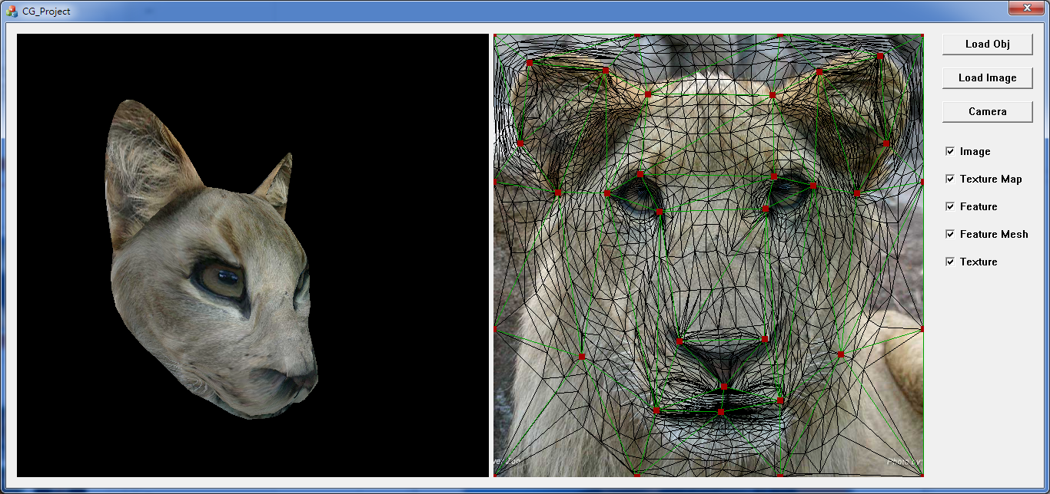
User Interface

Slide 9
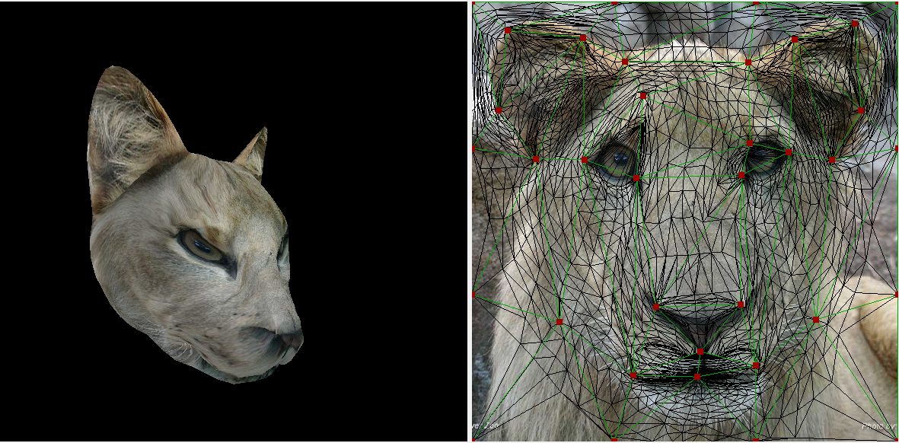
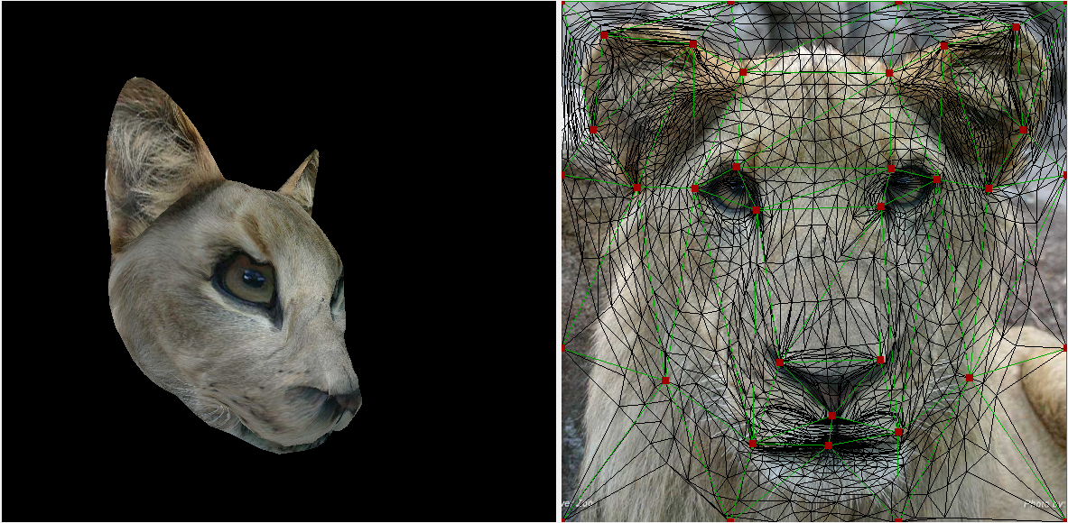
User Interface
Align the feature point to correct position.

Slide 10
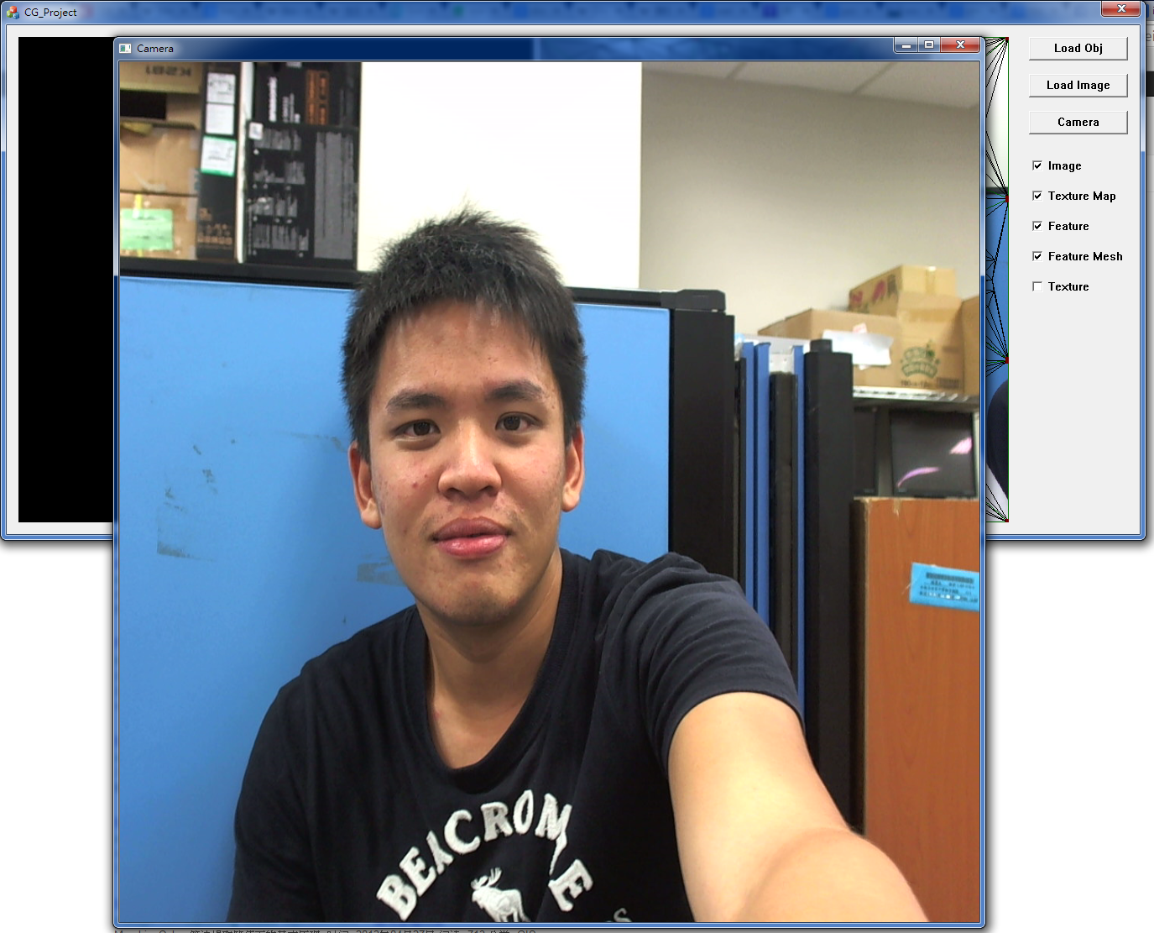
User Interface - Camera

Slide 11
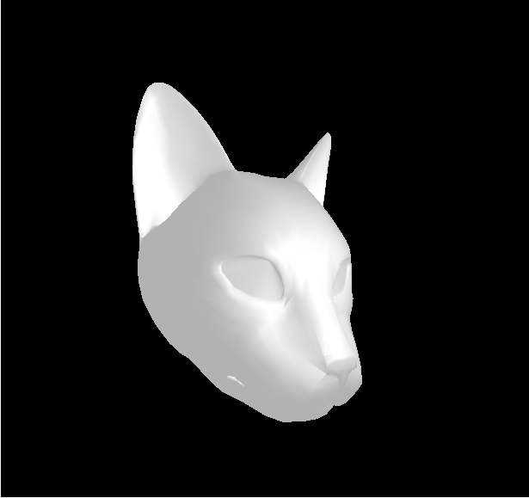
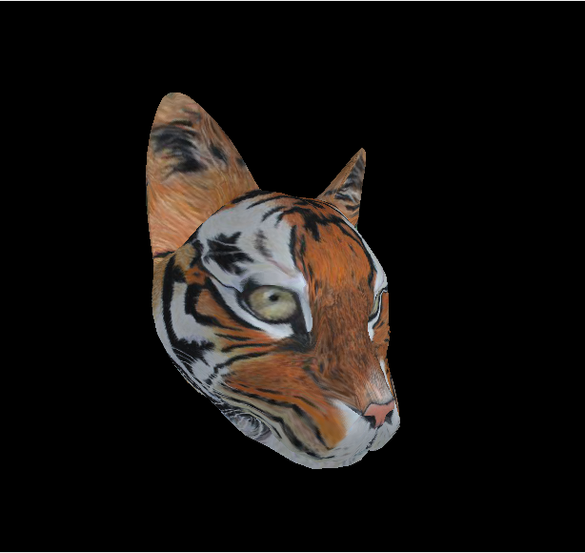
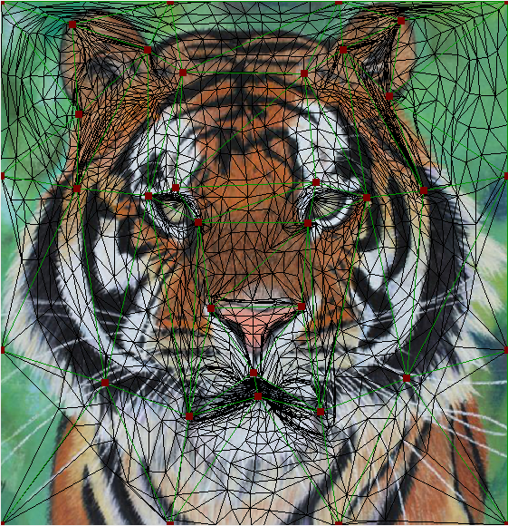
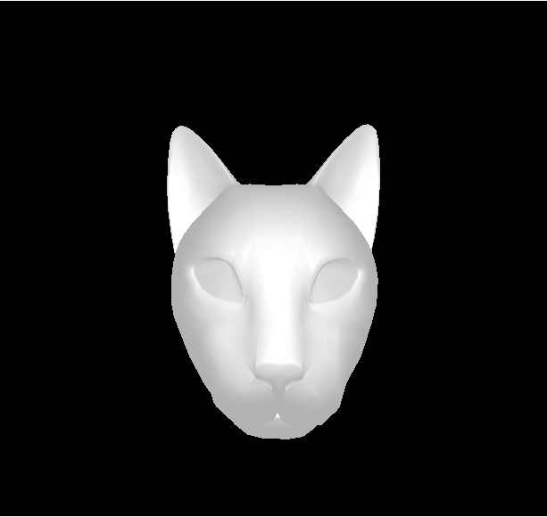
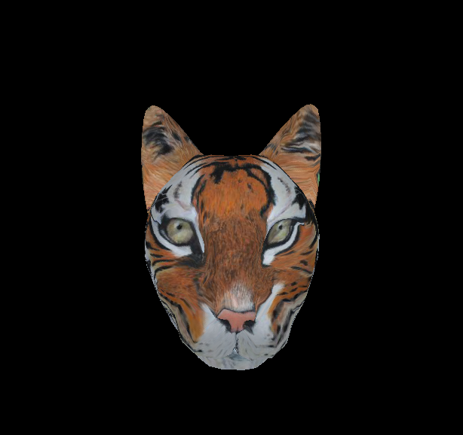
More Result

Slide 12
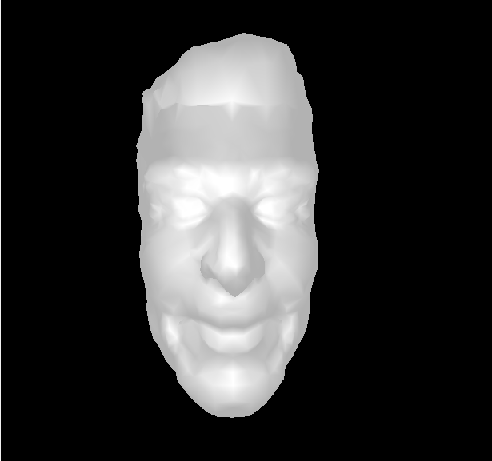
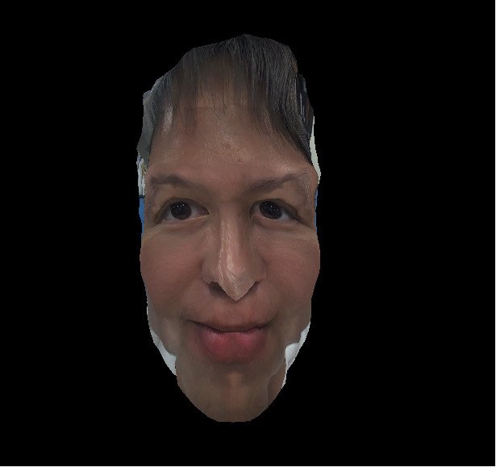
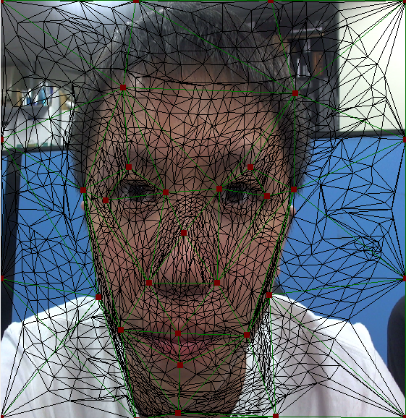
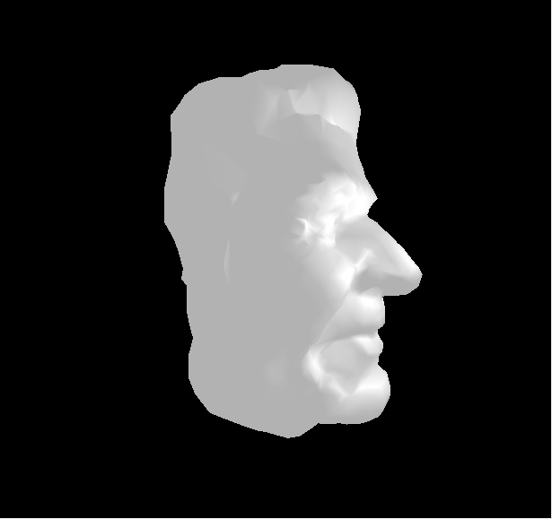
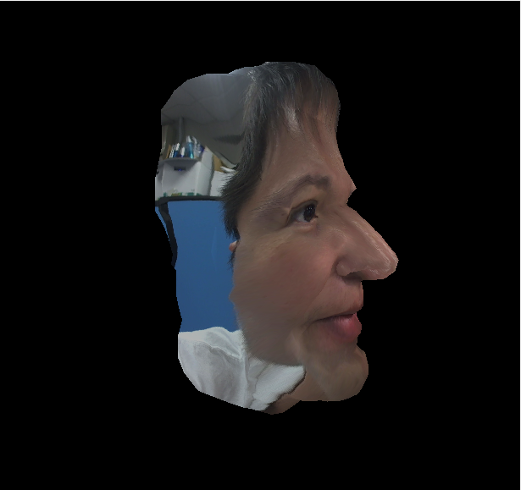
More Result

Slide 13
Demo

Slide 14
Reference
Papers
V. Kraevoy, A. Sheffer, and C. Gotsman, “Matchmaker: Constructing Constrained Texture Maps”, ACM Trans. Graphics, 2003.
Tong-Yee Lee , Shao-Wei Yen , I-Cheng Yeh, “Texture Mapping with Hard Constraints Using Warping Scheme”, IEEE Transactions on Visualization and Computer Graphics, 2008.

Slide 15
Thank You !

